Slide 1
Proactive Fault Tolerance in Fog Computing
Literature Survey

Slide 2
Paper 1: Dynamic Fault Tolerance Aware Scheduling for Healthcare System on Fog Computing
Journal: Iraqi Journal of Science (2021)
2093-Article+Text-32231-35264-10-20210129.pdf
Problem:
This paper proposes a Dynamic Fault Tolerance Aware Scheduling approach for healthcare applications in fog computing. It combines Dynamic Weighted Round Robin (DWRR) scheduling, Primary-Backup Replication, and Dynamic Checkpointing to ensure reliable task execution.
The proposed system:
Distributes tasks based on CPU and memory utilization.
Maintains backup copies of critical tasks.
Creates checkpoints only when needed.
Allows backup servers to continue execution if the primary server fails.
Key Contribution:
Intelligent task scheduling
Dynamic checkpointing
Primary-backup replication

Slide 3
Algorithm
Step 1: Receive IoT Tasks
Patient sensors continuously generate healthcare data (ECG, heart rate, temperature, etc.).
The data is sent to the Fog Scheduler.
Step 2: Dynamic Weighted Round Robin (DWRR) Scheduling
The scheduler checks the CPU and memory utilization of all available fog servers.
A weight is assigned to each server based on its current load.
The task is allocated to the fog server with the most suitable (highest) weight.
Step 3: Task Execution
The selected Primary Fog Server begins processing the healthcare task.
Step 4: Dynamic Checkpointing
During execution, the system continuously monitors CPU utilization.
If CPU utilization > 20%, a checkpoint is created.
The checkpoint stores the current execution state so processing can resume later if needed.
Step 5: Primary-Backup Replication
Every newly created checkpoint is replicated to a designated Backup Fog Server.
The backup server remains synchronized with the primary server.
Step 6: Failure Detection
The system continuously checks whether the primary fog server is functioning normally.
Step 7: Fault Recovery
If the primary server fails:
  The backup server immediately takes over.
  Execution resumes from the latest checkpoint instead of restarting from the beginning.
Step 8: Continue Processing
The task completes successfully.
Final results are delivered to the healthcare application and, if required, forwarded to the cloud for long-term storage.

Slide 4
Techniques
DWRR (Dynamic Weighted Round Robin)
Distributes incoming tasks among fog servers based on their current CPU and memory utilization, ensuring balanced workload and preventing server overload.
This improves throughput (up to 3290 requests/sec in the paper) and reduces response time by avoiding overloaded servers.
Primary–Backup Replication
Each primary fog server has a backup server that stores replicated task information. If the primary server fails, the backup immediately continues execution.
This minimizes service interruption and increases system reliability for critical healthcare applications.
Dynamic Checkpointing
Instead of saving task progress at fixed intervals, checkpoints are created only when CPU usage exceeds a threshold (CPU > 0.2).
This reduces unnecessary checkpoint overhead while ensuring faster recovery during server failures.

Slide 5
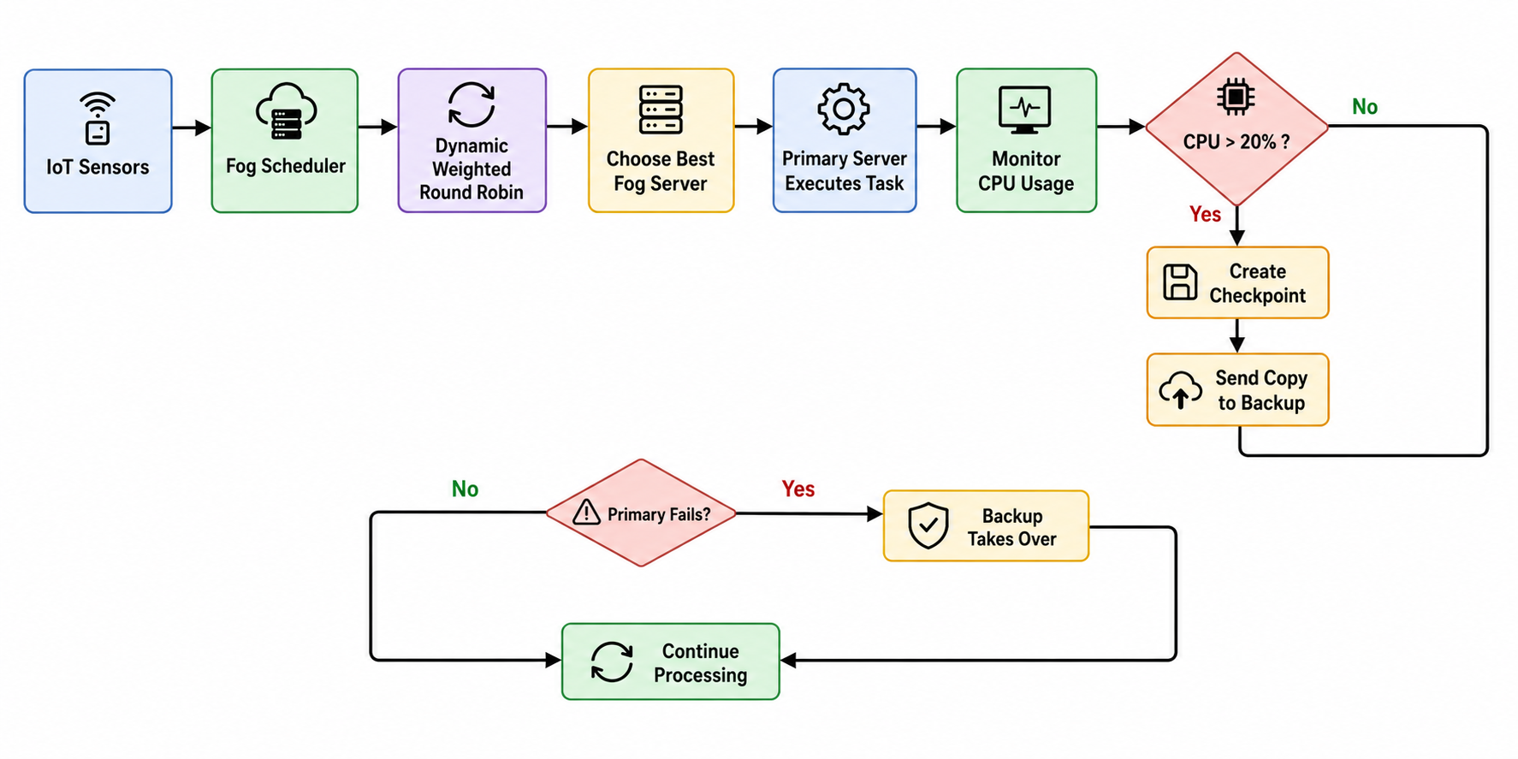
Methodology

Slide 6
Drawbacks
1. Fixed Threshold
The CPU threshold is fixed at 20%.
Different workloads might require different thresholds.
2. Extra Storage
The backup server stores replicated checkpoints.
This increases storage requirements.
3. Only Healthcare Tested
The experiments focus on a healthcare scenario.
Performance for other IoT applications (e.g., smart cities, industrial IoT) is not evaluated.
4. No Failure Prediction
The system reacts when conditions reach the threshold or when a failure occurs.
It does not use AI or machine learning to predict failures before they happen.

Slide 7
Paper 2: QoS Aware and Fault Tolerance Based Software-Defined Vehicular Networks Using Cloud-Fog Computing
Journal: Sensors (2022)
b33ca3499970ca4152ba9af462f1cb1a9674.pdf
Problem:
This paper proposes QAFT-SDVN (QoS Aware Fault Tolerant Software-Defined Vehicular Network), which integrates Software-Defined Networking (SDN), Fog Computing, and Quality of Service (QoS) to provide reliable communication in vehicular networks.
The proposed system:
Prioritizes safety-critical messages using QoS.
Processes urgent messages at nearby fog nodes to reduce latency.
Uses ACK-based retransmission to ensure reliable message delivery.
Key Contribution:
SDN-based intelligent routing
QoS-aware message prioritization
Reliable communication through ACK retransmission

Slide 8
Algorithm
Algorithm 1: Priority-Based Message Scheduling
Step 1: Generate Message
A vehicle generates a message (e.g., accident alert, traffic update, navigation request).
Step 2: Send to SDN Node
The message is forwarded to the nearest Road-Side Unit (RSU)/SDN Node.
Step 3: Forward to SDN Controller
The SDN Controller receives the message and makes centralized routing decisions.
Step 4: Classify the Message
The controller determines: Message Type (Safety or Non-Safety), Deadline & Message Size
Step 5: Assign Priority
Priority is assigned based on: Nature of the message (Highest Priority), Deadline, Message size
Ambulance Alert → Very High Priority, Entertainment Data → Low Priority
Step 6: Schedule the Message
Safety messages are immediately forwarded to the nearest fog node.
Non-safety messages are placed in a lower-priority queue.
Step 7: Process the Message
The selected fog node processes the message.
The processed message is delivered to the destination vehicle.

Slide 9
Algorithm
Algorithm 2: ACK-Based Fault Tolerance
Step 1: Send Message
The processed message is transmitted to the destination vehicle.
Step 2: Wait for ACK
The sender waits for an Acknowledgement (ACK) from the receiver.
Step 3: Verify Delivery
If the ACK is received, the message has been delivered successfully.
If no ACK is received within the expected time, the system assumes the message was lost.
Step 4: Retransmit Message
The sender retransmits the message.
Step 5: Repeat Until Successful
The process continues until an ACK is received.
This ensures reliable message delivery despite network or communication failures.

Slide 10
Techniques
Software Defined Networking (SDN)
Uses a centralized controller to intelligently manage network traffic and prioritize safety-critical vehicle messages over non-critical ones.
This reduces response time by nearly 50% and improves Quality of Service (QoS) for vehicular communication.
ACK-based Retransmission
After sending a message, the system waits for an acknowledgement (ACK). If no ACK is received, the message is automatically retransmitted to ensure reliable delivery.
This significantly reduces the message/task failure ratio and improves communication reliability.

Slide 11
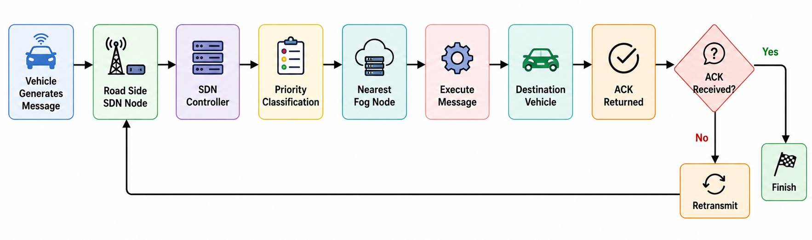
Methodology

Slide 12
Drawbacks
1. No Prediction
The system does not predict failures.
It only reacts after a message is lost.
2. Extra Communication
ACK packets and retransmissions increase network traffic.
3. Limited Domain
The work is designed specifically for vehicular networks.
It may need modifications for healthcare, smart homes, or industrial IoT.
4. Simple Recovery Strategy
If a message is lost, the only recovery action is retransmission.
There is no backup execution, checkpointing, or replica management.

Slide 13
Paper 3: Fault Tolerance Mechanism for Software Application Through Fog Computing as Middleware
Journal: International Journal of Computing and Digital Systems (2016)
b76d44b6ebca4db2fa8529aadae3d438878d.pdf
Problem:
This paper proposes a Fog Middleware-based fault tolerance mechanism to improve the availability of applications running on local servers.
Instead of allowing users to communicate directly with the server, a Fog Middleware is placed between users and servers to:
Continuously monitor server health using heartbeat messages.
Maintain a replicated backup server.
Automatically switch users to the backup server if the primary server fails.
Key Contribution:
Middleware-based fault tolerance
Heartbeat failure detection
Service replication

Slide 14
Algorithm
Step 1: User Request
A user sends a request to access the application.
The request is first received by the Fog Middleware instead of directly reaching the server.
Step 2: Heartbeat Monitoring
The middleware continuously sends heartbeat requests to the primary server.
The primary server responds with a heartbeat message indicating it is functioning normally.
Step 3: Server Health Verification
If heartbeat messages are received, the middleware considers the primary server healthy.
User requests continue to be forwarded to the primary server.
Step 4: Failure Detection
If the middleware does not receive a heartbeat response within the expected time, it detects that the primary server has failed.
Step 5: Activate Backup Service
The middleware immediately activates the replicated backup server, which contains the same application and data as the primary server.
Step 6: Automatic Failover
All incoming user requests are automatically redirected from the failed primary server to the backup server.
No manual intervention from users is required.
Step 7: Continue Service
The backup server continues processing requests, ensuring uninterrupted application availability until the primary server is repaired.

Slide 15
Techniques
Heartbeat Monitoring
The middleware continuously receives heartbeat signals from the primary server to check whether it is functioning correctly.
If heartbeat messages stop, the middleware immediately detects server failure and initiates recovery.
Service Replication
Application services and data are continuously copied from the primary server to a backup server, ensuring an up-to-date backup is always available.
This prevents data loss and enables the backup server to resume execution with minimal interruption.
Automatic Failover
When the primary server fails, the middleware automatically switches user requests to the backup server, allowing the application to continue with minimal downtime.
The prototype successfully recovered from 3 out of 4 simulated failure scenarios without manual intervention.

Slide 16
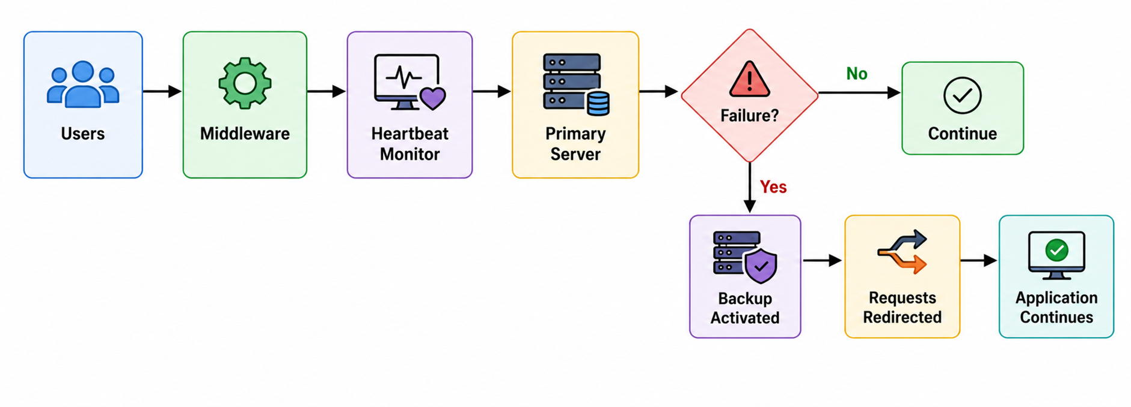
Methodology

Slide 17
Drawbacks
1. No Prediction
The middleware waits until the server stops responding.
It cannot predict future failures.
2. Single Backup
Only one backup server is considered.
If both the primary and backup fail,
the system stops.
3. Heartbeat Overhead
Heartbeat messages are sent continuously.
While each message is small, they consume network bandwidth and processing resources over time.
4. No Load Balancing
Unlike Paper 1, the middleware does not decide which server is less busy.
It only switches servers after a failure.

Slide 18
Paper 4: Opportunities of IoT in Fog Computing for High Fault Tolerance and Sustainable Energy Optimization
Journal: Sustainability (2023)
sustainability-15-08702.pdf
Problem:
This paper proposes QoS-EO (Quality of Service – Energy Optimization), a hybrid optimization approach for intelligent task placement in fog computing.
Instead of assigning IoT tasks randomly, it combines Particle Swarm Optimization (PSO) and Artificial Bee Colony (ABC) algorithms to:
Select the most suitable fog node for each task.
Optimize Quality of Service (QoS) and energy consumption.
Reduce node overload and improve fault tolerance through better resource allocation.
Key Contribution:
Intelligent task placement
Hybrid PSO + ABC optimization

Slide 19
Algorithm
Algorithm: Hybrid PSO–ABC Task Placement
Step 1: Generate IoT Tasks
IoT devices (sensors, cameras, smart traffic lights, etc.) continuously generate tasks.
These tasks are sent to the Fog Layer for processing.
Step 2: Collect Fog Node Information
The system gathers information about all available fog nodes, including: CPU utilization, Available resources, Energy consumption, Network conditions, QoS parameters
Step 3: Initialize PSO
Each particle represents a possible task-to-fog node assignment. The particles are initialized with random task placement solutions.
Step 4: Evaluate Fitness
Each solution is evaluated using a fitness function based on: Response time, Energy consumption, Reliability, Throughput, Execution cost
Step 5: Update Particle Positions (PSO)
Each particle updates its velocity and position using: Personal Best (PBest) & Global Best (GBest)
The swarm gradually moves toward better task placement solutions.
Step 6: Improve Solution Using ABC
Worker Bees evaluate the quality of the selected fog nodes.
Onlooker Bees choose the best solutions found by worker bees.
Scout Bees search for new solutions if existing ones are not satisfactory.
Step 7: Select the Best Fog Node
The hybrid PSO-ABC algorithm selects the fog node with: Lowest energy consumption, Lowest delay, Highest reliability, Best Quality of Service (QoS)
Step 8: Execute the Task
The selected fog node executes the IoT task.
Step 9: Monitor Performance
The system continuously measures: Response Time, Turnaround Time, Throughput, Reliability, Energy Consumption
Step 10: Repeat
The optimization process repeats whenever new IoT tasks arrive, ensuring continuous resource optimization.

Slide 20
Techniques
FTAPA (Fault-Tolerance Aware Placement Algorithm)
A hybrid algorithm that combines intelligent service placement, backup selection, and proactive migration to improve reliability in fog environments.
It maintains high system reliability (>0.85 in single-failure scenarios) while reducing service downtime.
DCLB (Dynamic Connections Load Balancer)
Selects the healthiest and least-loaded fog node based on active connections, ensuring balanced resource utilization.
This prevents node overload and improves overall resource efficiency across distributed fog nodes.
Threshold-Based Migration
Continuously monitors node health. If a node crosses a predefined fault threshold, the microservice is migrated to a backup node before failure occurs.
This proactive migration minimizes service disruption and reduces recovery time compared to reactive approaches.

Slide 21
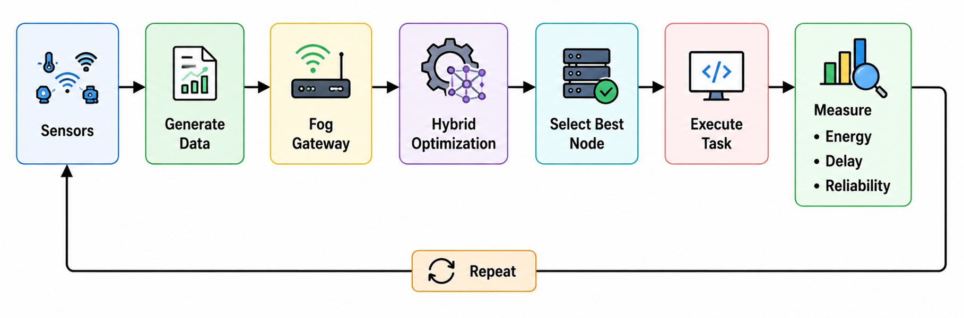
Methodology

Slide 22
Drawbacks
1. High Computational Complexity
Running two optimization algorithms (PSO and ABC) increases computation time.
2. Parameter Sensitivity
The performance depends on selecting appropriate values for PSO parameters (such as inertia weight and learning factors) and ABC settings.
3. Scalability Challenges
As the number of IoT devices grows, the optimization process can become slower due to the larger search space.

Slide 23
Paper 5: Optimized Fault-Tolerant Placement of Microservices in Distributed Fog Networks
Journal: International Journal of Data Informatics and Intelligent Computing (2025)
ijdiic_v4n4a5.pdf
Problem:
This paper proposes a Fault-Tolerance Aware Placement Algorithm (FTAPA) for fog computing that improves the reliability of microservice-based IoT applications.
Instead of waiting for a fog node to fail, the algorithm:
Selects the healthiest and least-loaded fog node using Dynamic Connections Load Balancing (DCLB).
Deploys the microservice on the selected node.
Preselects a backup node for recovery.
Continuously monitors the health of the primary node.
Proactively migrates the microservice to the backup node before a failure occurs.

Slide 24
Algorithm
Algorithm: Fault-Tolerance Aware Placement Algorithm (FTAPA)
Step 1: Receive Microservice Request
A new microservice request arrives from an IoT application.
The request is forwarded to the Fog Layer.
Step 2: Dynamic Connections Load Balancer (DCLB)
The DCLB evaluates all available fog nodes based on:
  Active connections
  Resource availability (CPU, memory)
  Node health
Step 3: Select the Best Fog Node
The healthiest and least-loaded fog node is selected.
The microservice is deployed on the selected Primary Node.
Step 4: Predetermine a Backup Node
At the same time, the system selects a Backup Node in advance.
The backup node is kept ready in case the primary node becomes unhealthy.
Step 5: Monitor Node Health
The system continuously monitors the health of the primary node.
A fault threshold is calculated to estimate the likelihood of failure.
Step 6: Compare with Fault Threshold
If the node health remains above the threshold, the service continues normally.
If the node health falls below the threshold, the system predicts an upcoming failure.
Step 7: Proactive Migration
Before the node completely fails, the microservice is migrated to the predetermined backup node.
This minimizes service interruption.
Step 8: Continue Service
The backup node continues executing the microservice.
Users experience little or no downtime.

Slide 25
Techniques
QoS-EO (Quality of Service – Energy Optimization)
Evaluates QoS parameters such as latency, reliability, and workload to select the most suitable fog node while minimizing energy consumption.
Particle Swarm Optimization (PSO)
A swarm intelligence algorithm inspired by bird flocking that searches for the optimal resource allocation by iteratively improving candidate solutions.
It helps identify resource allocations that reduce execution delay and improve overall system performance.
Ant–Bee Optimization
A hybrid optimization technique combining Ant Colony Optimization and Artificial Bee Colony algorithms to identify efficient execution paths and improve resource utilization.
It finds lower-cost execution paths while balancing energy consumption and Quality of Service.
Checkpointing
Periodically saves the current execution state of tasks so that processing can resume from the latest saved point if a failure occurs.
This improves fault tolerance by reducing task re-execution time and preventing complete loss of processing progress.

Slide 26
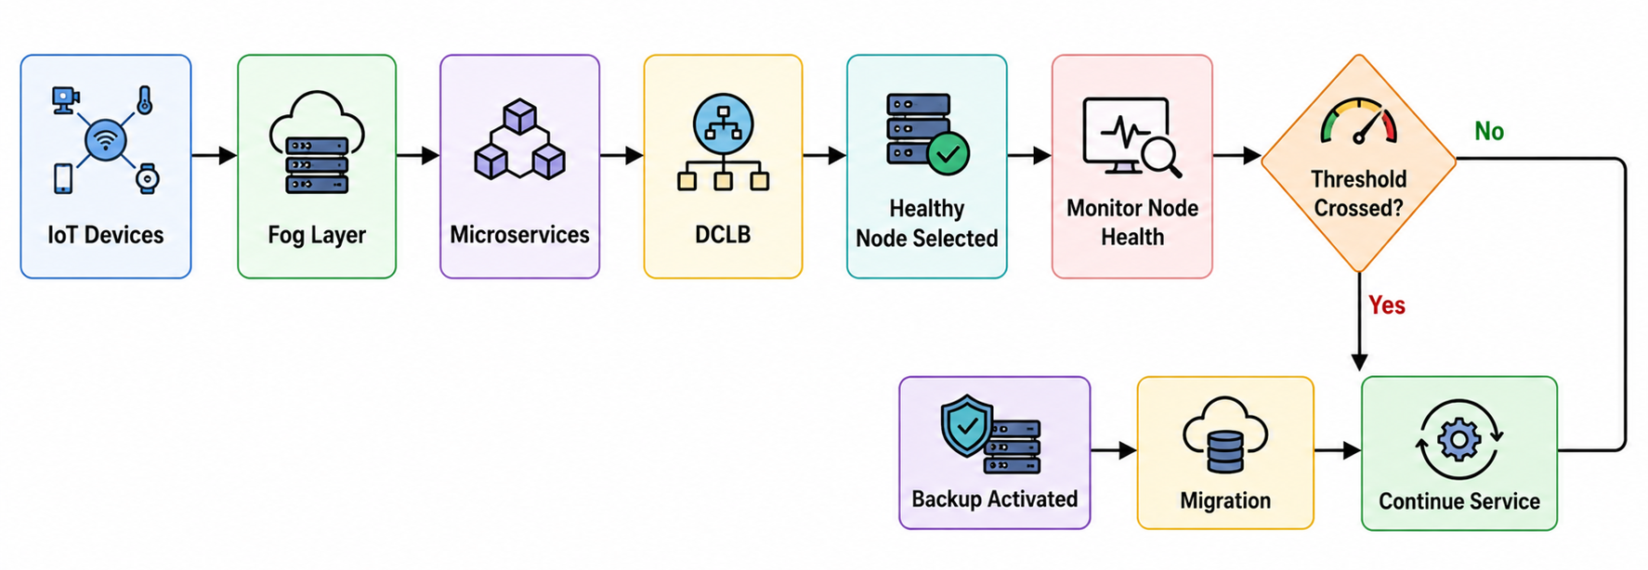
Methodology

Slide 27
Drawbacks
1. Backup Resource Cost
Maintaining backup nodes consumes additional memory and processing resources, even when failures never occur.
2. Threshold Selection
If the fault threshold is set too low, migration may happen too late.
If it is set too high, unnecessary migrations may occur.
3. Health Monitoring Overhead
Continuously monitoring node health adds some processing and communication overhead.

Slide 28
Thank You

